Slide 1
Leveraging Service Leads To Increase Revenue & Retention
Retail Women’s Network
Webinar

Slide 2
House Keeping
Lines will be muted during presentation
Q&A will be conducted at end of presentation
Presentation will be made available after this Webinar for you to reference in the future

Slide 3
Agenda
Service Leads 101
Keys To Success
Performance Management
Resources
FYI
Q&A

Slide 4
Service Leads 101

Slide 5
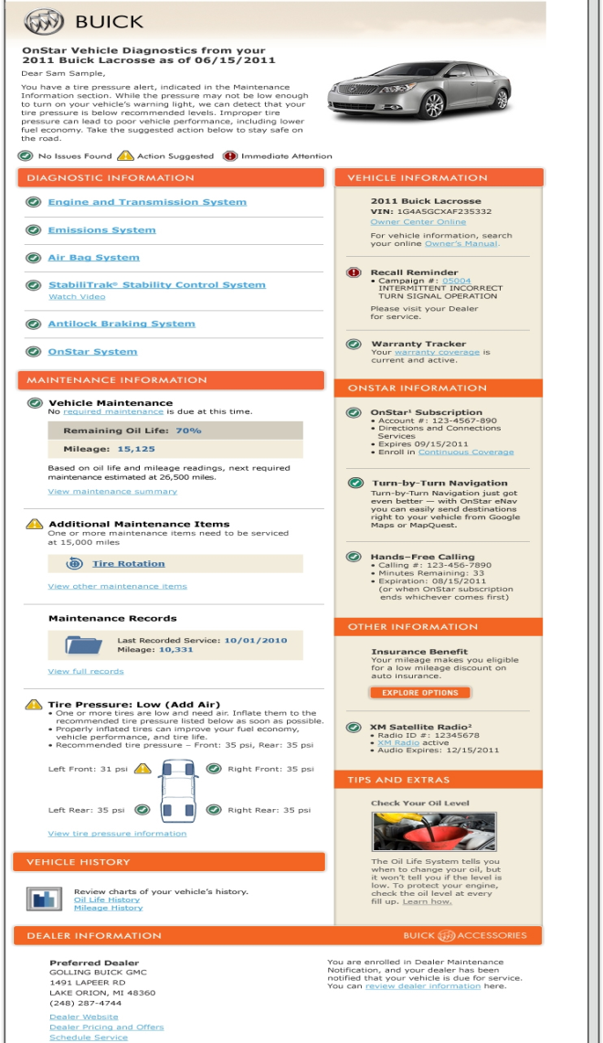
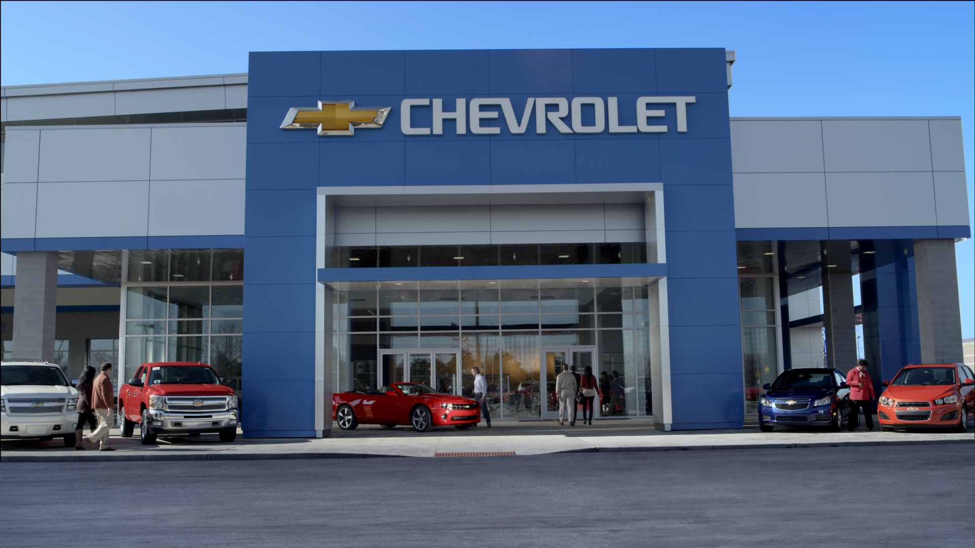
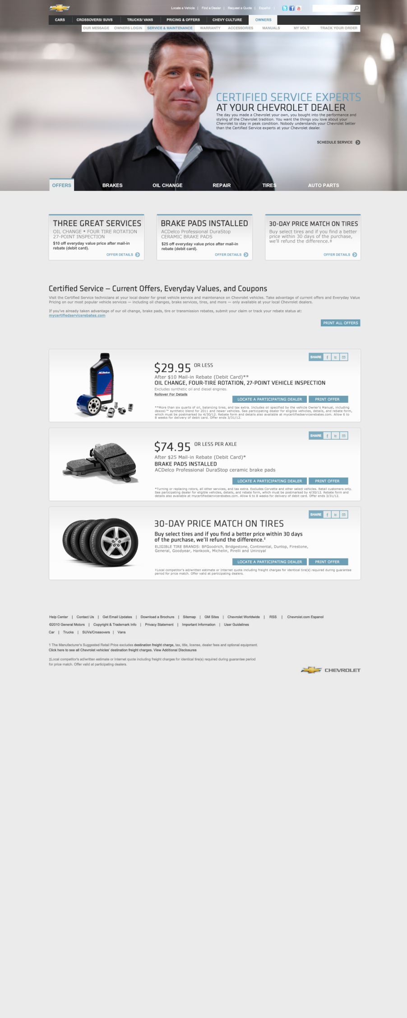
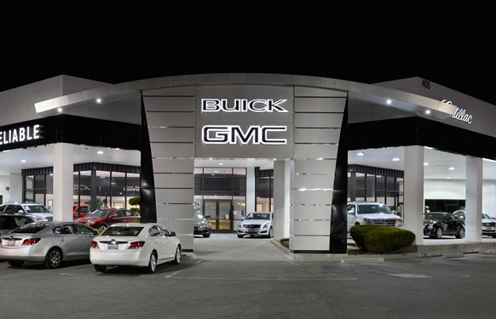

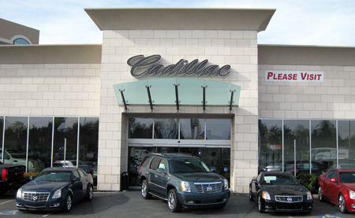


Service Lead Types & Delivery
OnStar Leads
- Oil Life Monitoring (OLM)
- Recalls
- Mileage Based Maintenance
- Diagnostic Alerts *New – Apr.*
*** System Generated ***
Certified Internet Dealers
DMN
“One Source” Lead Pipe
Web Leads
- Service Appointments
- Parts Requests
- Tire RAQ
*** Customer Generated ***
Dealer Web Phone
- Service Appointments
- Parts Requests
- Tire RAQ
- Etc.
*** Customer Generated ***

Slide 6
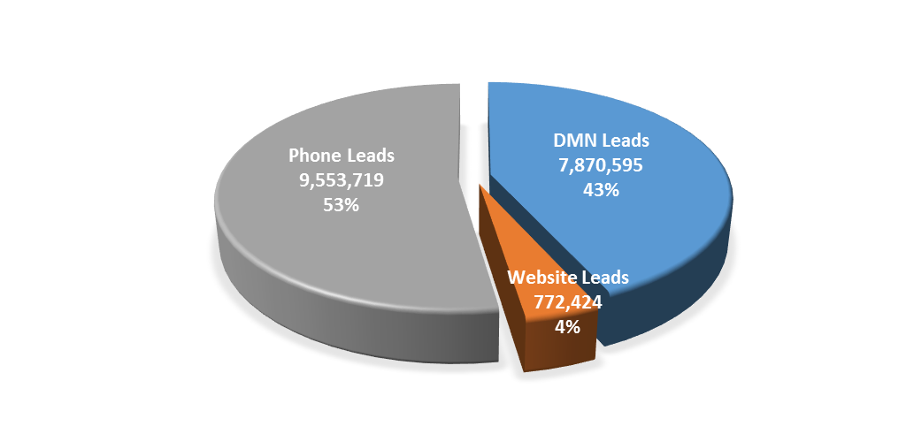
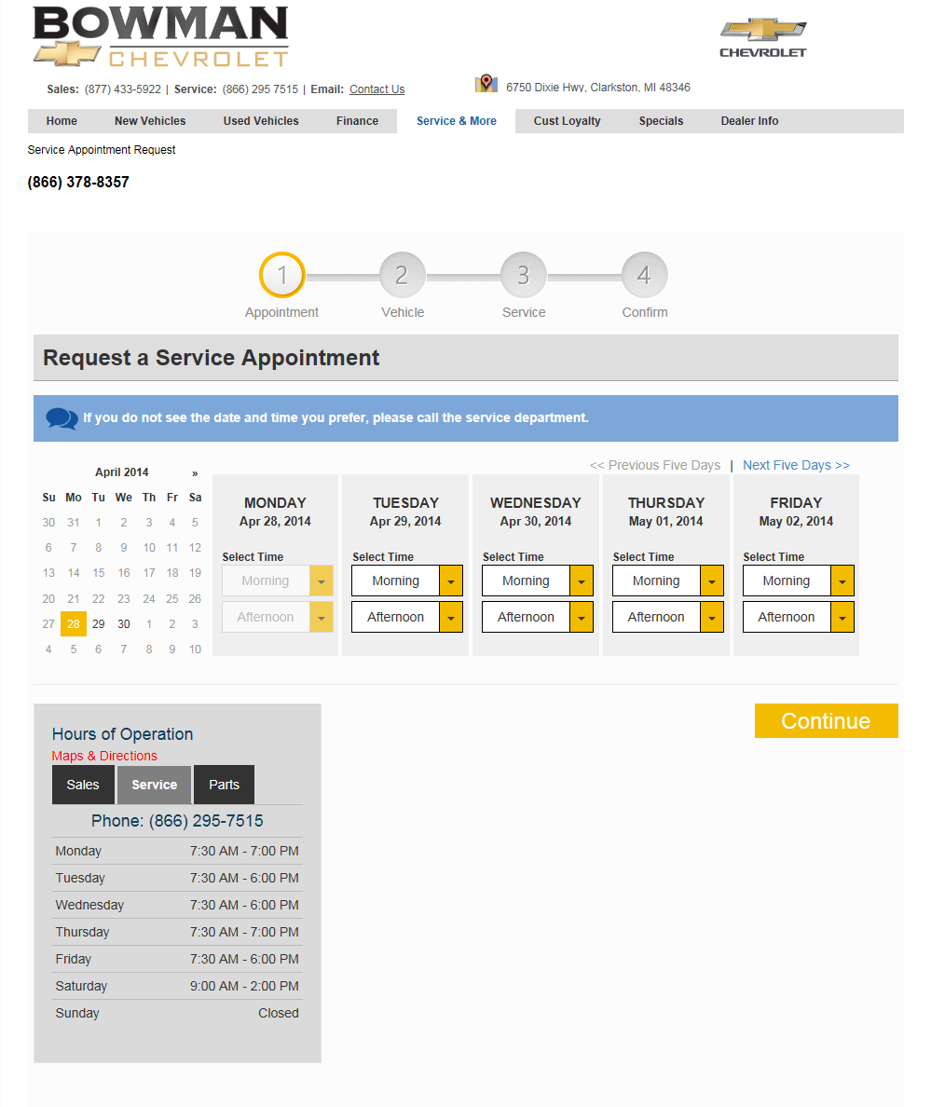
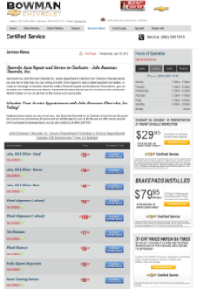
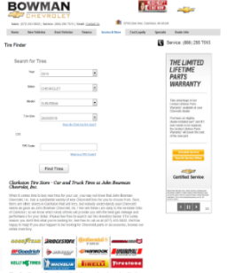
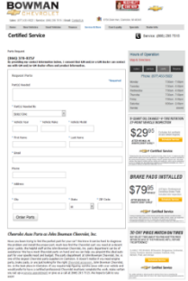
Service Lead Allocation - 2015
~18.2M Leads In 2015
~1.5M Leads Monthly
~50k Daily
(555) 555-5555
(555) 555-5555

Slide 7

2015 Service Lead Highlights
Revenue Generated
The Opportunity
18.2M Leads analyzed
(DMN, Web & Phone)
18.2M Leads analyzed
(DMN, Web & Phone)
Conversion:
DMN: 26%
Web: 73%
Phone: 23%
Did Not Convert
26.2%
Convert to RO
73.8%
LOST Customers
$247
Average RO Value
$247
Average RO Value
~ $300K Per Dealer
~ $800K Per Dealer
$1.2B Annual Dealer Revenue
$3.3B Missed Opportunity

Slide 8
2016 Service Lead Objectives
National & Regional Objectives
DMN Lead Close Rate
2.5pt Improvement Over 2015
Web Lead Close Rate
2pt Improvement Over 2015
Dealer Objectives
DMN & Web Lead Close Rate
Top 3rd In The Region
Note: Worth 30% - Service BDC Assessment

Slide 9
Keys To Success

Slide 10

1.) Service BDC Implementation

Slide 11
Service BDC Implementation Cont.
Individual(s) Identified, Responsible & Accountable For Service Lead Management
Certified Lead Mgt. Tool Set-Up & Configured
Consistent & Documented Processes In Place To Effectively Manage The Customer Experience
BDC Team & Service Department Integrated
  Continuous dialogue/feedback between teams
Performance Management In Place
  Lead Close Rate (Top 3rd In Region)
  Appointment Penetration (+50%)
  Appointment Show % (+85%)
  BDC Representative Performance & Productivity
    Includes Ongoing Lead Response & Phone Call Quality Audits & Evaluations

Slide 12
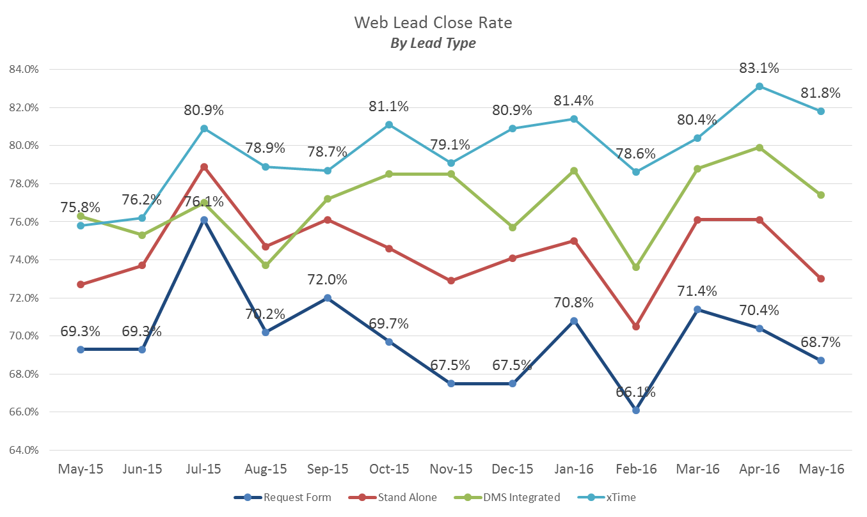
2.) Approved OSS Tool Adoption
WHY?
Confirmed Appointments Based On Dealer Capacity & Advisor Availability
Highly Configurable/Customizable Settings
  Text & Email Options
  Waiting Room & Amenities
  Service Lane Capacity Planning
Appointment Management screens
Depending On Tool, Opportunities To Integrate Directly w/DMS
  GM OSS can currently integrate w/Automate, CDK & Dealertrack (Working on Reynolds)
OPTIMAL CUSTOMER EXPERIENCE!!!!!!!
*** +13% Variance In Close % Depending on OSS Tool Utilized ***

Slide 13




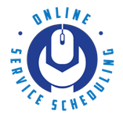

3.) Do The Basics – And Do Them Well!
Implement an appointment reminder process
Implement a missed appointment follow-up process
Utilize lead response templates for digital leads
  Professional, Personable, Efficient & Effective
Drive Service Lane traffic by leveraging lead generation resources
Always Include:
- Contact person name and info
- Direct phone number and email – OFFER TEXTING!
- Website, videos, customer REVIEWS
- Offer a value prop. and answer their questions, GIVE PRICING
- Be proactive – suggest next steps
- Survey them if they don’t buy to find out why

Slide 14
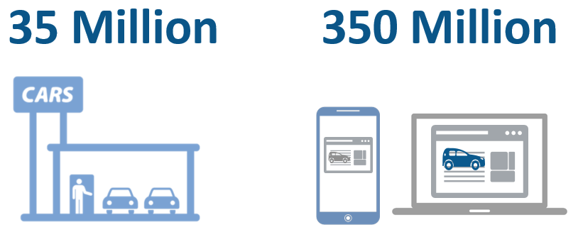
Service BDC Best Practices
Leverage the Service BDC to handle both Service Phone Calls & Inbound Leads (Central Point For Appointment Scheduling)
Utilize the most effective communication channels
Maximize customer enrollment in the OnStar DMN program (+78%)
  Not Just The Sales Team’s Responsibility!
Digitally Market your service department
  Specials
  Menus
  Pricing
  Etc.
Notes:
Last year, 35 million customers visited brick and mortar car dealerships…while 350 million customers visited the car dealerships T3 website
~70% of Customers shopping online for Service make a decision where to buy w/in 1 day (Compass Tour Slide)
~60% of the customers who visit a dealer’s T3 website is shopping for Service

Slide 15
Performance Management

Slide 16
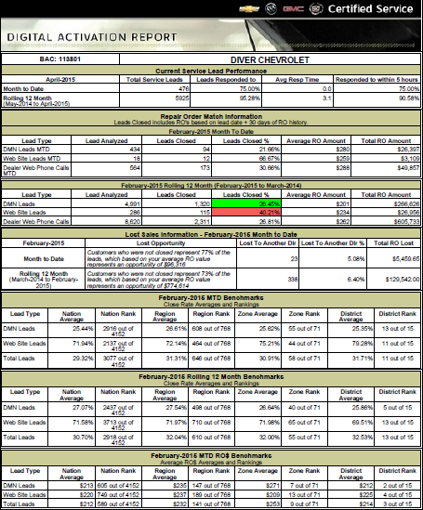
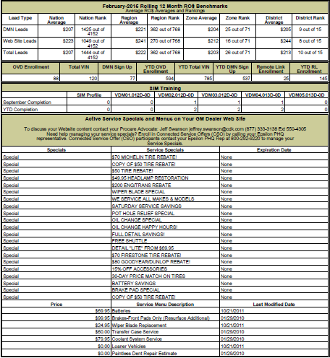
Digital Activation Report
Location: Global Connect → Departments → Parts → View Dealer Daily Report
Section 1
  Lead Response Performance
Section 2
  Repair Order Match Detail
Section 3
  Benchmarks & Rankings
Section 4
  OnStar Enrollments (DMN, OVD & RL)
Section 5
  Service Lead Training
Section 6
  Dealer Website Specials & Menus
1
2
4
5
3
6
Review Monthly!

Slide 17
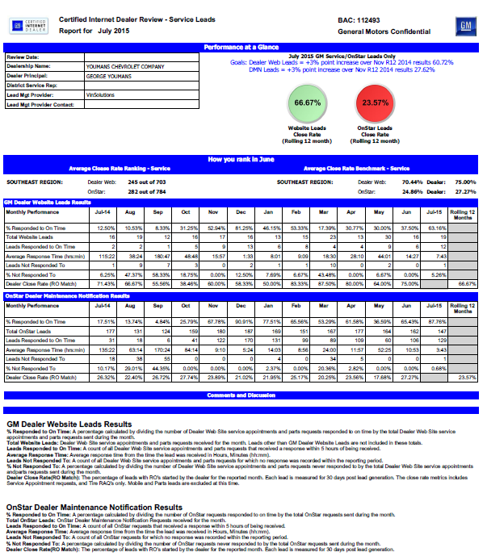
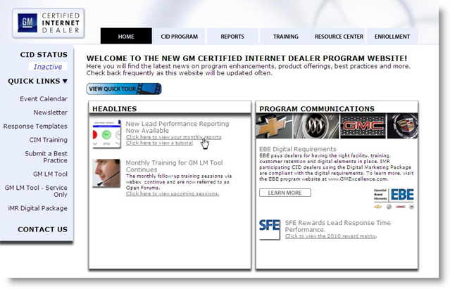
CID Service Lead Report – The “DOT” Report
Location: GC → CID Website Reports → Reports Tab → Service Leads Report

Slide 18
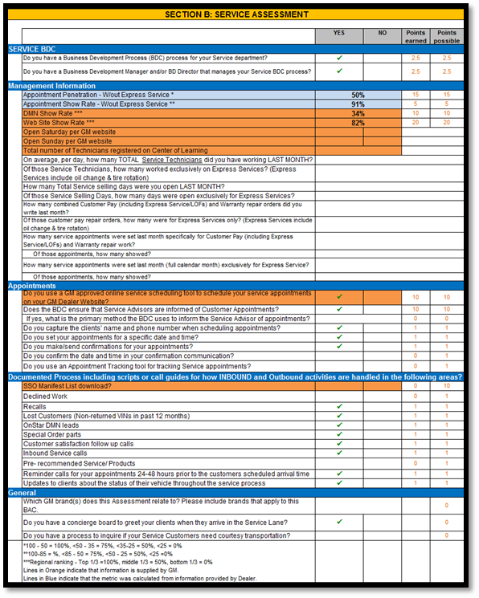
Quarterly BDC Evaluation
New For 2016:
Weightings
  50% Process & Compliance
    Documented processes, Approved OSS, SSO downloads, etc.
  50% Performance
    Appt. Penetration, Appt. Show %, DMN & Web Lead Close %
Added columns showing points earned and points possible
Rows highlighted in blue indicate a calculation based on information provided by the dealer
Rows highlighted in orange indicate the data is provided by GM
Added formulas to show how scores were derived

Slide 19
Available Resources

Slide 20
Service Lead Resources Available
Location: Global Connect → GM Program Info → CC&A → Certified Service → Customer Retention
Service Lead Training (Center-of-Learning)
Course 1 - Growing Your eGame
Course 2 - Lead Handling
Course 3 - Basics of Service Lead Management
Course 4 - Attracting and Retaining Internet Customer
Course 5 - Advanced Tools to Build Relationships
Course 6 – Increasing Customer Retention with Advanced . Diagnostics – Dealer Maintenance Notifications
Phone Skills Training (Center-of-Learning)
Course 1 – Phone Etiquette
Course 2 – Converting Service Calls Into Appts.
Course 3 – Optimizing Service Calls

Slide 21


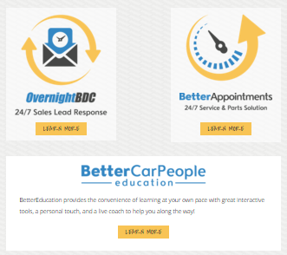

The Experts
Certified BDC Vendors
Service Lead Mgt.
  877.852.2753
  www.bdcexperts.com
  800.929.8478
  www.travertech.com/GMBDC
  888.304.4545
  www.ownerconnect-llc.xom
  855.448.429
  www.bettercarpeople.com

Slide 22
For Your Information

Slide 23
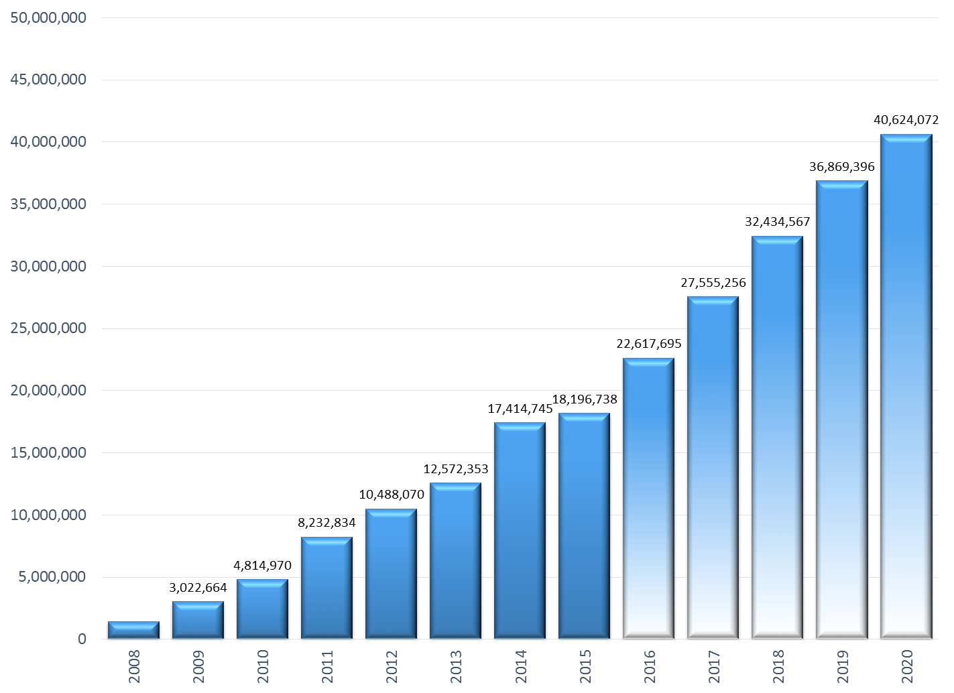
Service Lead Volume Projections – Next 5 Years
2020 Highlights:
Volumes more than double vs. 2015
Service Leads worth ~$2.4B+ in annual revenue
Forecast

Slide 24
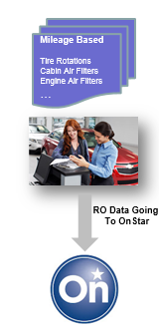
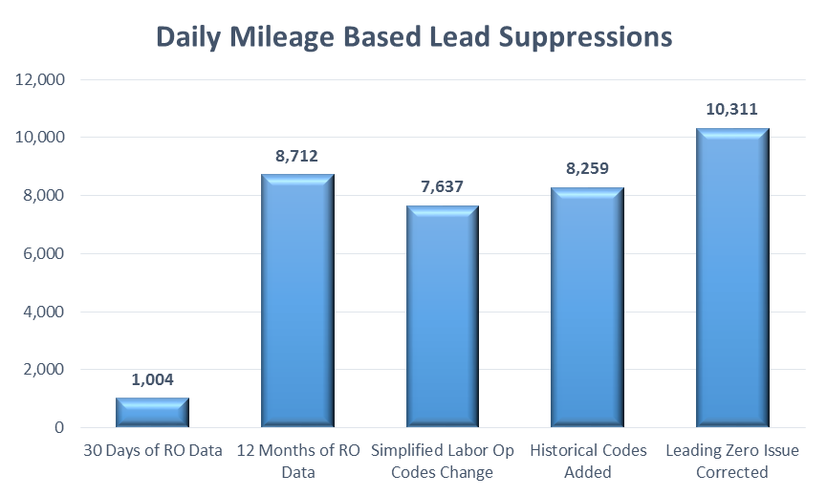
The DMN RO Data Service Now Fully Implemented!
Leveraging all RO data from dealers allowing for suppression of leads for a service a customer already completed
  Monthly Diagnostic Reports E-Mailed To Customers (OVD Reports)
  DMN Leads Sent To Dealers
Note: Dealers need to be mapped to the appropriate GM Labor Op Codes
April - 2014
May - 2015
June - 2015
July - 2015
August - 2015
Notes:
Launched using 30 days of RO data
Updated to consider 12 months worth of RO data (However, if the vehicle has been driven over a certain mileage amount since RO than will still send lead (i.e. 6k for Tire Rotations)
Labor Opp team simplified the Labor Op codes, we were unaware…so we added simplified codes as well as pulled in historical codes
Some of our Labor Opp codes had a “leading 0” which data service did not account for. Made adjustment @ the data service level

Slide 25
Other Notables
Diagnostic Alerts – Launched April 18th
  Real-time alerts for items like oil life, flat tire, odometer-base maintenance, DTC, and critically low battery
  New Dealer Alerts will include:
    Oil Life (5% or less)
    Diesel Emission Fluid (75 miles until DEF is empty)
    Bulb Outages
DMN Leads Integration Into SSO (Implemented Yesterday)
  In/Out AGSSA Data (i.e. Close %)
  List Pulls
  Maps
Service Digital Performance Report (Q3 Launch)

Slide 26


Slide 27
BACKUP

