Slide 1
RHENEA CULP
Customer Care and Aftersales
North Central Region
Notes:
PES 2

Slide 3
KRISTIN PAYNE
AUTOMOTIVE HEAD OF INDUSTRY
Google
Notes:
PES 2

Slide 4
Google: Connecting with Today’s Digital Consumer
Notes:
PES 2

Slide 5
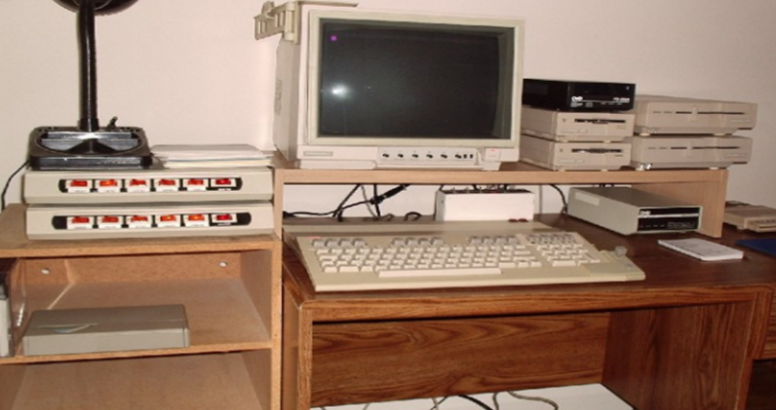
Notes:
Remember this?
I graduated college in the early 2000’s, not ALL that long ago and I felt really lucky at the time. I had my own computer and didn’t need to go to the library like many of my friends to research and write my papers. It might take me 15 minutes just to dial up but I felt like I was on the cutting edge!

Slide 6
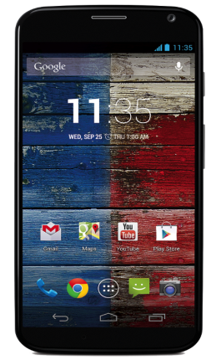
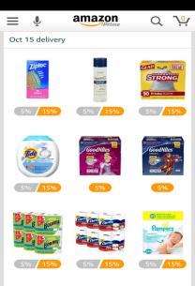
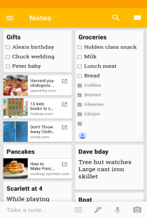
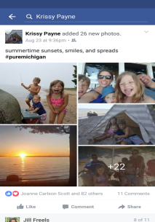
Notes:
Fast Forward 14 years and every day I carry in my hand a computer more powerful. This shift has profoundly changed the way we live our lives.

Slide 7
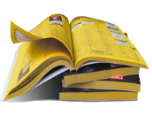
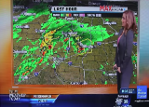
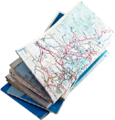
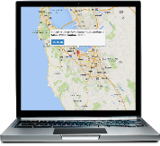
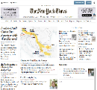
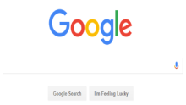
THEN NOW
Notes:
almost every daily task has been redefined over the last 20 years
you read your news online
weather is an app on your phone

Slide 8
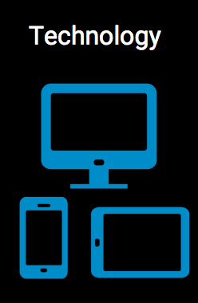
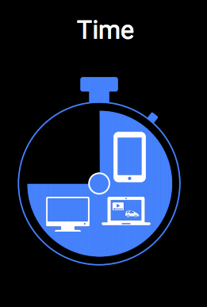
Consumer Behavior: 3 Guiding Trends
Notes:
There are three trends we believe are important to help us better understand how consumer are evolving.
Technology - as we are discussing the proliferation of affordable mass produced technology means it's finally accessible for everyone.
Transparency - we know knowledge is power and today proximity or physical locations are not needed to share your opinion or to even offer many products. Look at the rise of automotive review sites, some of which are really just individuals sharing their opinions.
Finally, time. The more chaotic and busy our world has become the more we lean on technology to help us solve problems quickly at any time day or night.
This is why as a whole we see foot traffic to stores down +50% and searches up +xx%.

Slide 9
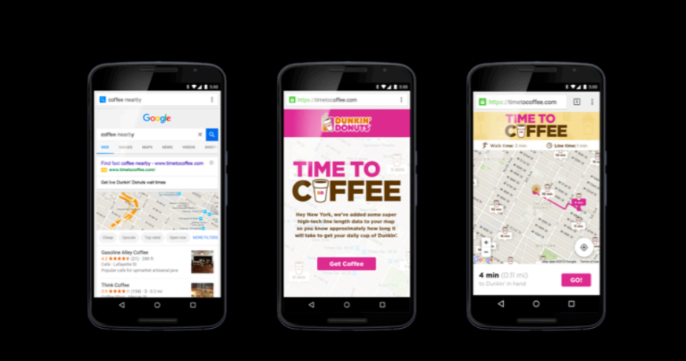
Notes:
and businesses are tapping into this shift as an opportunity to redefine how they service their customers.

Slide 10
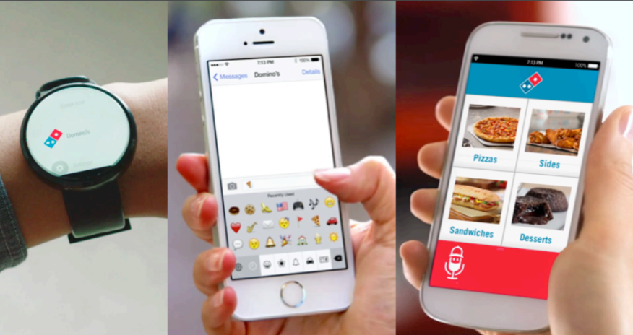
Notes:
Domino’s even lets you order a pizza from any device - you can even text them a pizza emoji! AND you get to see the name of the person making your pizza. That is a very personalized service. Order in whatever form you like and they’ll let you know who’s making your pizza!

Slide 11
How does this apply to my business?
Notes:
But you may be asking yourself so what? How does this apply to my business.

Slide 12
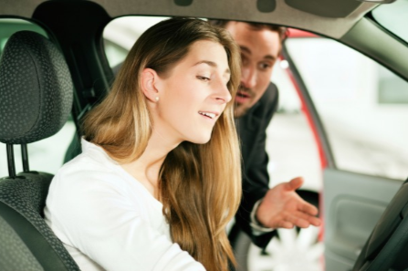
Old Mantra:
Get Customers into the Dealership

Slide 13
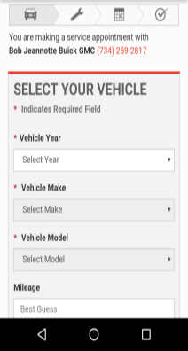
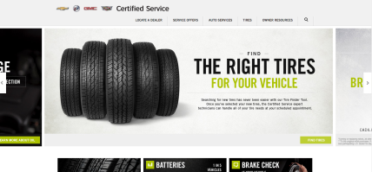
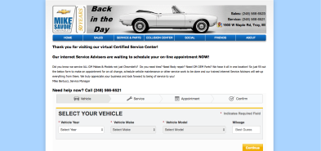
New Mantra:
Bring Your Dealership to the Customer

Slide 14
State of the Auto Shopper Today
Why Fixed Operations is Key
Opportunities
Notes:
Three focus areas for today…

Slide 15
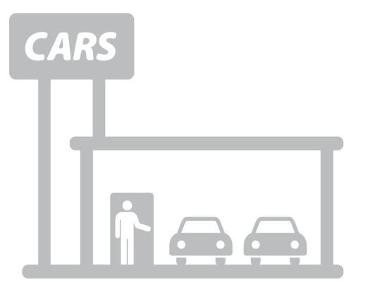
1.6
Dealer Visits
vs. 5 in 2005
Source: 1 in 6 Car Buyers Skips Test-Drive; Nearly Half Visit Just One (Or No) Dealership Prior to Purchase,
DME Automotive, April 2014
Notes:
Very few people actually make it to a dealership today. When someone walks into your showroom, know they are well researched and ready to buy.

Slide 16
Less than half
Of auto shoppers are brand loyal
Source JD Power 2015
Notes:
You can’t count on traditional OEM loyalty to drive your sales. Only half of shoppers will purchase the same brand again.

Slide 17
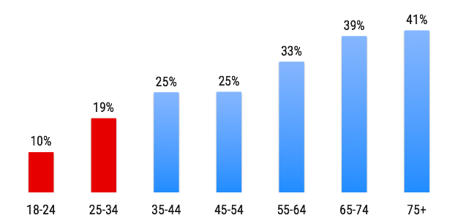
Brand Loyalty by Age
Source JD Power 2015
Notes:
And loyalty by age shows for even more disruption to come.
% that bought the same brand as the car they replaced

Slide 18
read professional review
visited dealer website #1
visited newspaper site
Looked at photos
Visited OEM website
Saw a TV ad
filled out a form
watched video on YouTube
browsed newspaper ads
loan calculator on 3rd party site
test drove a vehicle
located a dealer from mobile
read consumer reviews
influenced by
online ad
search dealer inventory on Tier 2
clicked display ad
Visited a brand’s social page
watched video ad
visited a dealership
searched on mobile
Inquired family, friends colleagues
used model comparison tool
Built-and-priced on OEM site
24 average touchpoints, 19 are digital
Source Google Automotive Shopper Path to Purchase 2015
Notes:
all this means you MUST influence the consumer BEFORE they step foot into your dealership. today a vast amount of the time consumers are open to influence happens online. 75% of their time is dedicated to online research.

Slide 19
62%
of women say they do not feel confident when buying a car
Source: http://www.autoremarketing.com/trends/why-women-visit-more-dealerships-than-men
Notes:
and we’d be remiss to mention that all of this is even more pronounced among women and millennials for a variety of reasons.
We know women tend to not be as comfortable buying a car as men (men 47%). So although women influence 85% of all purchases a majority of us don’t feel confident buying a car. This means they research more and take longer to buy than men making the resources we provide outside of the brick and motar dealer location even more important to this group.

Slide 20
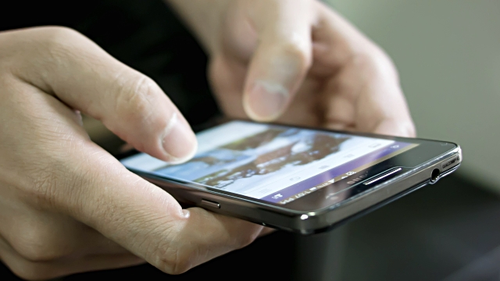

Slide 21
State of the Auto Shopper Today
Why Fixed Operations is Key
Opportunities
Notes:
You all know that fixed ops is a big business. In fact its a $310M business that OEM/ Dealerships get less than 30% of. Its also brings in the highest profit margin in your business. Most stats show parts is at least 3X more profitable than a new car sale and service margins are well above that level.

Slide 22
80%
Up to
of shoppers who service their vehicles at your dealership purchase or lease another vehicle
Source: industry ranges
Notes:
Shoppers who service their vehicles at your dealership 2x/yr are
80% more likely
to purchase or lease another vehicle from your dealership

Slide 23
SERVICE CENTER VISITED
A service center chain
An independent auto service shop
The car manufacturer’s dealership
44%
38%
17%
Source: Google Consumer Surveys ‘Where did you take your vehicle for service?’ A18-44, March 2014 (n=1519)
Notes:
where do drivers head for service?
**according to Google shopper study survey**

Slide 24
24%
all ages
32%
ages 18-44
% of drivers who did not know which service center to visit
Source: 2015 Critical Mix-Google Services Path to Purchase Study
Notes:
undecideds
, April 2015, N=1500, B5. Thinking back to when you first decided to get your vehicle serviced, did you know which service center you would visit?

Slide 25
How do we influence these shoppers?

Slide 26
Notes:
Let’s go back to our guiding consumer trends

Slide 27
70%
of drivers research service online before they purchase
(regardless of where they buy)
Source: Google Auto Parts/Accessories Purchase Study 2013

Slide 28
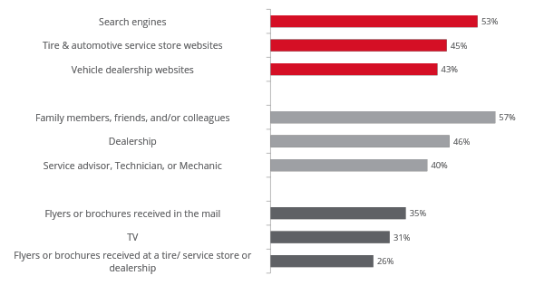
Drivers are increasingly using digital sources
Sources Used to Gather Info on Service Centers
online
in person
offline
Source: 2015 Critical Mix-Google Services Path to Purchase Study

Slide 29
79%
Made a purchase within one week
Source: 2015 Critical Mix-Google Services Path to Purchase Study

Slide 30
State of the Auto Shopper Today
Why Fixed Operations is Key
Opportunities
Notes:
You all know that fixed ops is a big business. In fact its a 310M business that OEM/ Dealerships get less than 30% of. Its also brings in the highest profit margin in your business. Most stats show parts is at least 3X more profitable than a new car sale and service margins are well above that level.

Slide 31
Opportunities
Be there when customers ask for you
Focus efforts where consumers spend time

Slide 32
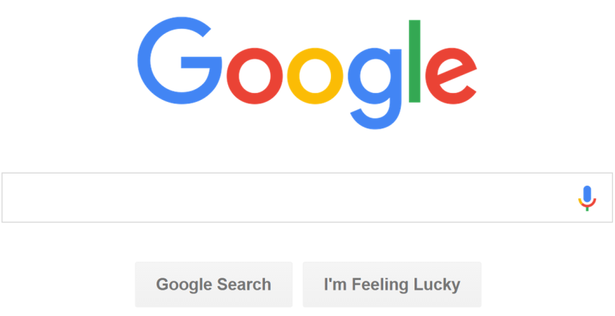
Notes:
We’ve already talked about how search is the #1 resource for finding answers and auto shoppers - vehicle as well as parts and service turn to search first. Google is by far the largest search site and in most cases is by far and away the largest lead driver for dealers websites today.

Slide 33
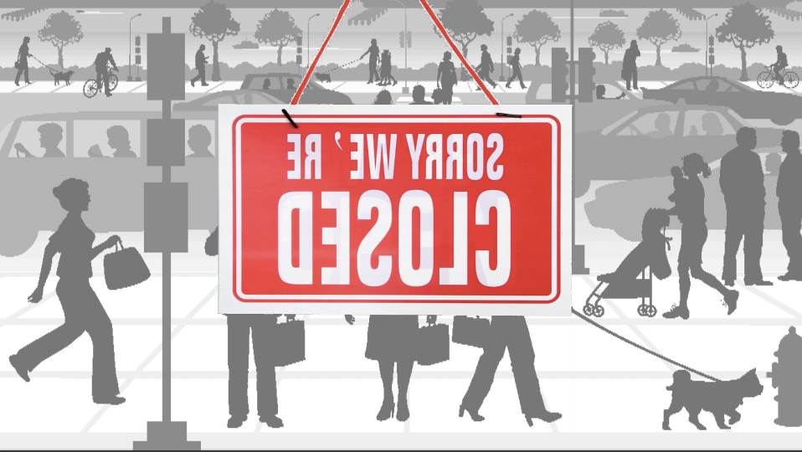
Notes:
Remember our new mantra – bring your dealership to the customer.
Not having a digital presence is like putting a closed sign outside your business.

Slide 34
Research
Consideration
Purchase Intent
70M
#1
2/3
monthly fixed ops queries searched on Google.com
most leveraged resource (traditional & digital) in the shopping process
of visits to your dealership website are coming from Google.com
Source: Google Internal Data, 2014
Source: Millward Brown/Google, 2014
Source: Automotive News, 2014

Slide 35
Percent using search when researching their service center
70%
drivers 18-44
75%
drivers 18-44
Mobile
Desktop
Source: 2015 Critical Mix-Google Services Path to Purchase Study
Notes:
and these trends are even more pronounced when we look at younger demos

Slide 36
Have you searched for an oil change lately?

Slide 37
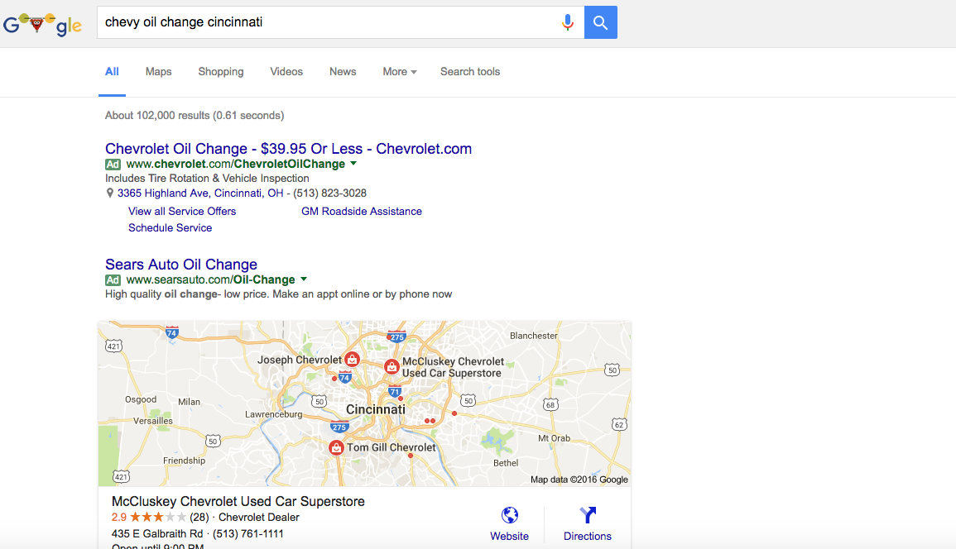

Slide 38
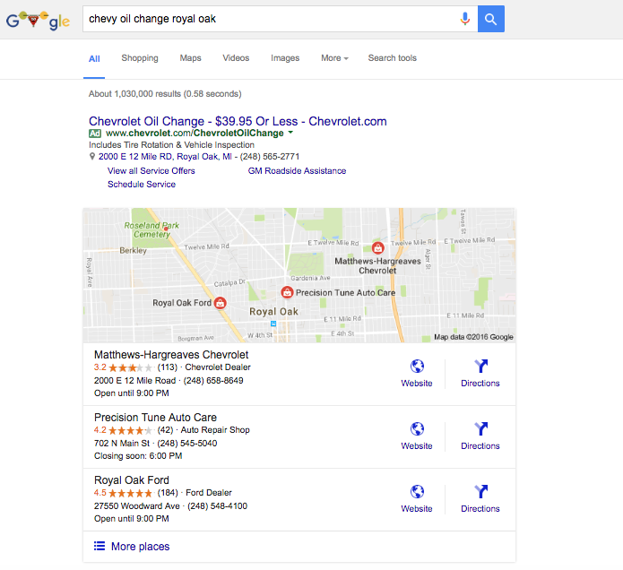
Notes:
And organic needs to provide relevant results also based on proximity to the query…

Slide 39
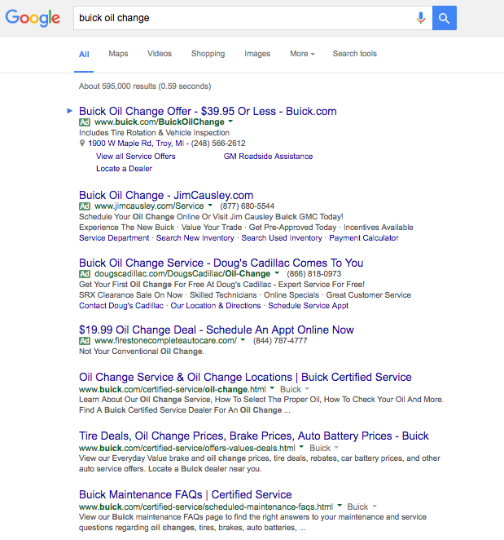
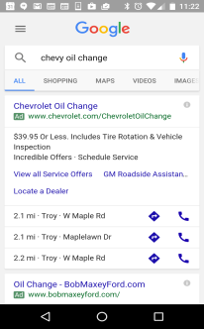
Tier 1
Dealer
T3
Dealer
T3
T3
Dealer
Notes:
This is what Toyota’s search presence looks like for an oil change in cinci. Coordinated coverage by the OEM and Dealers.
Its more effective to do this with search than other mediums because you only pay when a user clicks - all of the eyeballs are free.

Slide 40
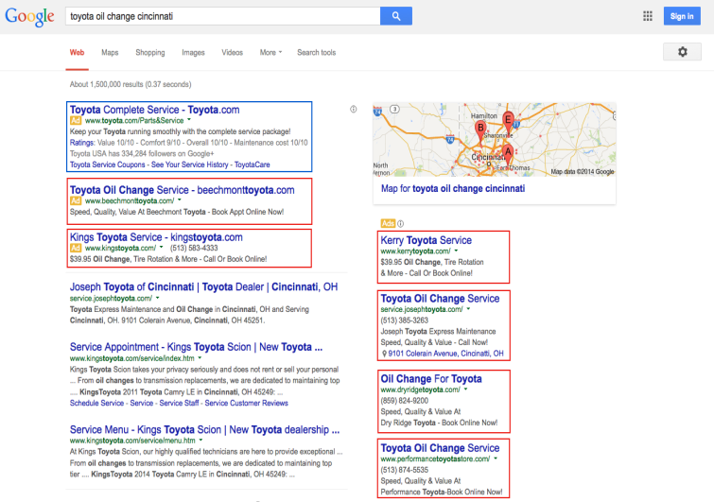
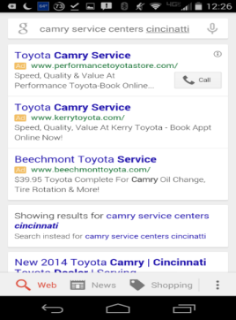
T1
T3
T3
T3
T3
T3
T3

Slide 41
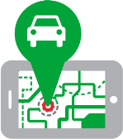
Keywords for Area
Zip Code / Radius
Cost per Click
Notes:
Why is coverage on search different than other media outlets?

Slide 42
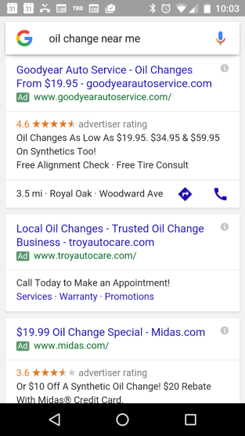
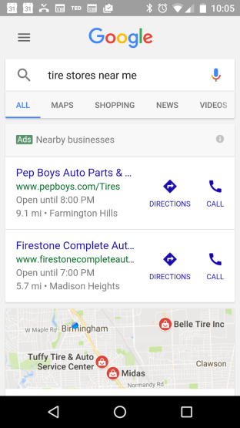

Slide 43
Search Tactic #1 Organic + Paid
88%
avg. increase in clicks when appearing in the top paid and organic position
Source: Google Internal Data
Notes:
Tip 1. This is pretty basic. Make sure your dealerships are showing up when customers search for your service centers. They should bid on their dealership names. Research shows that click thru rates increase by as much as 88% when your store appears in the top paid and top organic spot. Most users will click on your organic listing and on average you are only paying for clicks 35% of the time.

Slide 44
Search Tactic #1 Organic Tips
Find Your Site:
Referrals
Meta Data
Site Maps
Understand Your Site:
Useful Content
Type Descriptions
Use the Site:
Links to Live pages
Load Time
Check Across Devise and Browser
Contact your ProCare advocate to discuss further!
Notes:
The key to organic is the help Google and site visitors find you, understand you and use the site.

Slide 45
Search Tactic #2: Branded Keywords
Potential Keyword Organization Models Across Tiers
Tires
Oil
Maintenance
Battery
Transmission
Service
Suspension
Brakes
Parts
Repairs
Filters
Make + Model + P&S Category
Make + P&S Category
Model + P&S Category
Notes:
Tip #2: Start with Branded Keywords (chevy, gmc ,etc) before branching out to generic keywords. Start by increasing your coverage of GM branded terms and capture customers who are already looking for GM service centers. These are your lowest funnel customers and they are your easiest customers to bring into your service lanes.

Slide 46
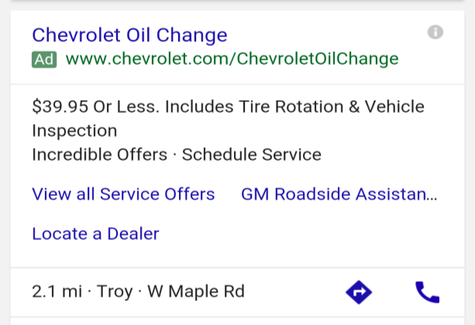
Search Tactic #3: Sitelinks & Extentions
Notes:
Tip #3: Implement sitelinks and extentions on on all ads.
Sitelinks appear on both desktop and mobile. They are the little blue links in your ad that provide more information and direct customers to deeper pages of your website. These are free and they increase your CTR’s 10-20% and as much as 20-50% for brand terms. They also make your ads larger and take up more screen space.
Call Extentions - allow users to call right from the ad unit. No code necessary, advertisers simply supply a business number and we are able to use our forwarding numbers to track call activity. Best practice is to define a 60 second call as a conversion. Average CTR increase is 6-8%
Location extentions Provide an extra line in your ad highlighting your business location. Customers instantly get directions directly from your ad. Average CTR increase is 10%

Slide 47
Be there to answer their questions!
Capture customers interested in your services
Drive traffic to dedicated parts and services landing pages on the dealer sites
Increase leads for fixed operations
Notes:
setting goals

Slide 48
How do we connected with undecideds?

Slide 49
Adults 18+ Media Consumption
Internet
48%
Desktop
23.9%
TV
36%
Mobile
24.4%
Radio
12%
Print
3%
Notes:
how consumers spend their time today is shifting. old mediums to connect and influence are becoming harder to utilize.

Slide 50
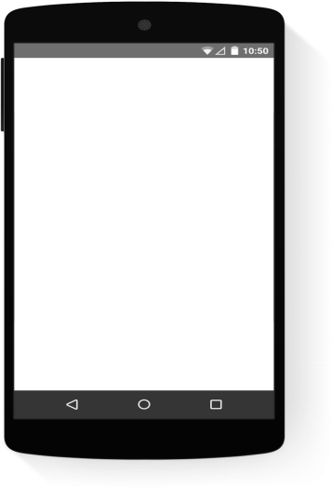
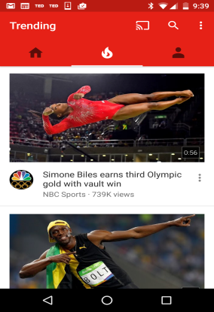
Growing Importance:
Video
(especially mobile!)
Notes:
YouTube creates a great opportunity to get in front of your customers using the power of site, sound and motion. YouTube also allows scale larger than any TV network today that is also paired with targeting that makes it relevant.

Slide 51
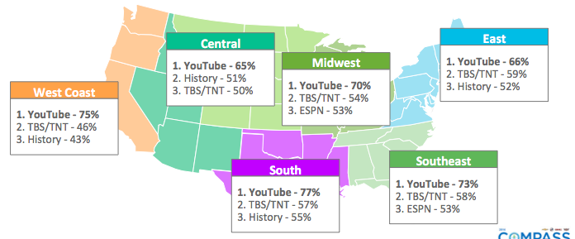
Notes:
Youtube offers more reach than any broadcast / cable channel for 25-54 anywhere in the US

Slide 52
102B
minutes
Monthly watch time for A25-54 of online video
36B
10B
3.8B
1.6B
1.2B
Total online video watch A25-54
6.8B
3.8B
Comcast
NBCUniversal
YouTube
Netflix
Facebook
Yahoo!
Hulu
Microsoft
80% visit YouTube
Notes:
While also offering more reach than any other online video

Slide 53
102B
minutes
Monthly watch time for A25-54 of online video
is 35% of all online watch time
36B
10B
3.8B
1.6B
1.2B
Total online video watch A25-54
6.8B
3.8B
Hulu
Comcast
NBCUniversal
YouTube
Netflix
Facebook
Yahoo!
Microsoft
80% visit YouTube
Notes:
While also offering more reach than any other online video

Slide 54
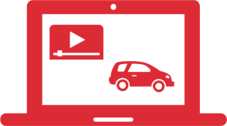
Right Customers
DMA
Cost Per View
Notes:
But we know that you don’t want to target EVERYONE and a broad TV strategy may never have been one of your business tactics. With digital video not only is it where people are increasingly spending time its a place where you can be much more targeted.

Slide 55
The Right Customers:
Your Customer Data
Target customers that you know
Reach users similar to your customers

Slide 56
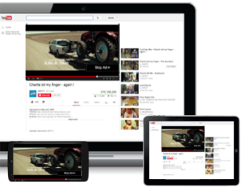
Pay per View
Only pay for views:
Skippable video after 5 seconds
Pay at :30 seconds or the completion of the video whichever comes first

Slide 57
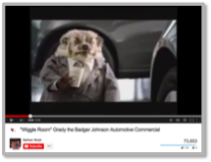
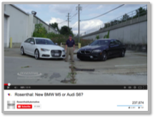
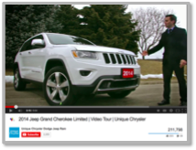
Existing TV Creative
Web Produced
Smartphone Video
Notes:
And there are many ways to provide useful messaging.

Slide 58
YouTube: Getting Found
Thumbnails
Meta Data

Slide 59
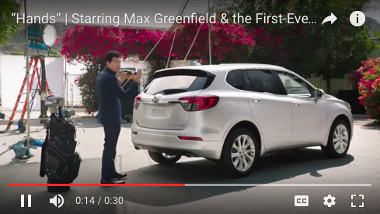
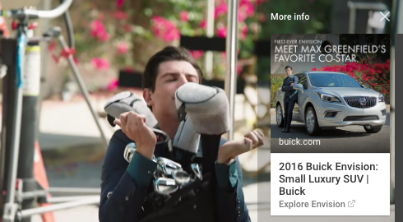
YouTube: Driving Engagement

Slide 60
Focus efforts where consumers spend time:
Video, especially mobile continues to make up a high percentage of your customers day
Get in front of undecideds that may not outwardly ask about your business
Create demand for parts and service at your dealership
Notes:
setting goals

Slide 61
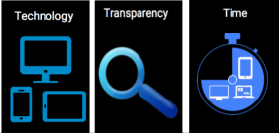
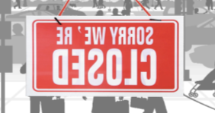
Customer Expectations are Changing
Lack of Digital Presence can be like a
*Closed* sign on your business
Digital media can offer targeted ways to
connect with your customers at scale

Slide 62
Q&A

Slide 63
Thank You

