Slide 2
STEPHANIE GELH
Customer Care and Aftersales
Western Region
Notes:
PES 1

Slide 4
KRISTIN SOWLE
SENIOR DIRECTOR
J.D. Power

Slide 5
Using CSI/SSI to
Attract Female Buyers
Notes:
PES 3

Slide 6
Elevating the Customer Experience
Listening to the Voice of the Customer
General Motors
September 2016

Slide 7
U.S. Light Vehicle Retail Sales (2010-2020F)
Since 2010, unit sales have grown steadily in the U.S. market yet the pace of growth is slowing
Source: LMC Automotive
Notes:
Static – sales forecast

Slide 8

Industry Customer Experience Programs
Over that time, automakers and dealers have invested aggressively in the customer experience and added dedicated staff / departments
New measurement tools
Product specialists
Dedicated CX departments
Margin programs
Consulting and culture change

Slide 9
Historical SSI and CSI Scores
The pace of SSI and CSI score growth is slowing, which suggests customer expectations are changing just as quickly as dealers are improving
19 pts.
1 pt.
25 pts.
15 pts.
Source: J.D. Power 2015 U.S. Sales Satisfaction Index (SSI) and 2016 U.S. Customer Service Index (CSI)
Notes:
Static – SSI Historical Scores

Slide 10
Evolving Customer Expectations
Voice of the Customer: J.D. Power’s SSI and CSI Studies
Summary and Recommendations
Delivering an Elevated Customer Experience
Today’s Discussion

Slide 11
Voice of the Customer:
J.D. Power’s SSI and CSI Studies

Slide 12
Syndicated Research Methodology
2015 U.S. Sales Satisfaction Index (SSI) Study
2016 U.S. Customer Service Index (CSI) Study
Sample Frame | New car buyers/lessees: 2014-2016 model years 90 days after purchase/lease April-May, 2015 registrations | Original owners of light vehicles (personal use vehicles): Dealer service experience within the last 12 months Highest concentration of ROs June through December 2015 Maintenance, repair and recall visits. Recall included as part of repair
Research Methodology | Online surveys: Fieldwork completed July-September, 2015 Randomly drawn national sample Invitation letter to an online survey | Online surveys: Fieldwork completed between October and December 2015 Randomly drawn national sample Invitation letter with $1 response incentive and $100k sweepstakes
Brand Ranking | New car buyers: Buyer – 32 ranked brands Rejecter – 31 ranked brands Award based on overall index (50% Buyer & 50% Rejecter) | Thirty-three ranked brands: CSI award based on 2013-15 MY vehicles September through February registrations (2012-15) Tesla is not included in the ranking due to non-representative sample
Sample Size | Data weighted based on sales: 27,831 customer responses 2,095 Chevrolet responses 628 Cadillac responses 592 Buick responses 734 GMC responses | Data weighted based on sales: 72,752 customer responses 5,812 Chevrolet responses 2,122 Cadillac responses 1,913 Buick responses 2,170 GMC responses

Slide 13
2015 Sales Satisfaction
Index (SSI) Study

Slide 14
2015 Overall SSI Industry Rank
Cadillac falls one rank position. Buick suffers a decline, due to poor Rejecter scores. Chevrolet and GMC maintain their respective positions.
Notes:
Static – SSI Historical Scores

Slide 15
2015 Buyer Index Industry Rank
Mercedes-Benz tops the list. Cadillac improves to #3. Buick and Chevrolet improve rank while GMC falls slightly. All GM brands significantly above average.
Notes:
Static – SSI Historical Scores

Slide 16
2015 Buyer Industry Rank by Gender
Female Cadillac and Buick owners report higher satisfaction than Chevrolet and GMC
“Salesman and finance department. The manager on duty was not pleasant to work with. He was short tempered and told me I didn't know what I was talking about with the employee discount. I had to force him to use the instructions from the employee discount program supplied by my son to get the discount to work properly and I was correct, manager was wrong and didn't bother to apologize.”
Notes:
Static – SSI Historical Scores

Slide 17
2015 Buyer Attributes by Gender
Buick
Cadillac
Lexus
Premium
Variety of inventory
Ease of coming to agreement on price
Fairness of price paid
Clarity of explaining documents
Ease of looking at dealer's inventory
Comfort of the area where negotiated
Courtesy
Condition of your vehicle
Honesty
Timeliness of completing delivery
Concern that you purchased best vehicle for your needs
Responsiveness
Thoroughness in explaining features
Timeliness of completing the final paperwork process
Knowledge/expertise
Appearance of facility
Honesty of the person who handled paperwork/finance process
Difference (Female-Male)

Slide 18
2015 Buyer Attributes by Gender
Chevrolet
GMC
Ford
Non-Premium
Condition of your vehicle
Timeliness of completing delivery
Fairness of price paid
Courtesy
Thoroughness in explaining features
Variety of inventory
Ease of coming to agreement on price
Honesty
Honesty of the person who handled paperwork/finance process
Appearance of facility
Ease of looking at dealer's inventory
Responsiveness
Clarity of explaining documents
Timeliness of completing the final paperwork process
Comfort of the area where negotiated
Concern that you purchased best vehicle for your needs
Knowledge/expertise
Difference (Female-Male)

Slide 19


2015 SSI Top Key Performance Indicators by Gender
GMC
Female Male
On delivery, staff showed how to operate navigation system
Dealer contact after delivery to ensure everything was satisfactory
Female GMC buyers, compared to male, are less likely to get a straightforward price
83%
81%
90%
89%
Received an answer to, “At what price will you sell me the vehicle?”
Vehicle delivered without issues
91%
90%
95%
95%

Slide 20
GMC Female Buyer Comments
“Excessive time waiting (8 hours) and pushy financial personnel”
“After signing the paperwork and during delivery of my Acadia, I noticed 2 small gouges in the dash that were not there beforehand. Sales person agreed and told me he'd contact me because the guy to fix it isn't there often. Four months later-still not fixed. Manager was rude. He's the reason I won't do business with this place again. Back seats had mud on them upon delivery. Floor mats are VERY cheap quality.”
“Our salesman tried to contact myself and my husband multiple times a day. We were very bothered by it especially since we told him from the beginning that we needed time to make our decision and did not want to be harassed.”
“Final price was excessive as I found out in the next three months through online and newspaper ads.”
“I would have liked to get more for my trade. I think they were intentionally low balling my offer.”
“Worst car experience of my life. Purposely cause 7 hours of wait until store was closing to pressure you through the paperwork and full of mistakes. Rude and unprofessional. Tried to buy my positive survey with free tanks of gas (in writing).”
“Told there would be an incentive to buy before coming in to look at the truck and then told there where not any incentives”

Slide 21
2015 Rejecter Index Industry Rank
MINI leaps to first. Buick falls. Chevrolet, Cadillac and GMC are relatively stable.
Notes:
Static – SSI Historical Scores

Slide 22
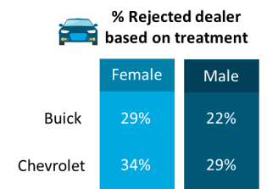

2015 Rejecter Industry Rank by Gender
Females are more likely to reject Buick and Chevrolet because of dealer treatment
Notes:
Static – SSI Historical Scores

Slide 23
2015 Rejecter Attributes by Gender
Buick
Cadillac
Lexus
Premium
Experience negotiating
Dealership's facility
Fairness of the price the dealer offered
Variety of inventory
Experience working with the salesperson/dealer personnel
Difference (Female-Male)

Slide 24
2015 Rejecter Attributes by Gender
Chevrolet
GMC
Ford
Non-Premium
Fairness of the price the dealer offered
Dealership's facility
Experience negotiating
Variety of inventory
Experience working with the salesperson/dealer personnel
Difference (Female-Male)

Slide 25
2016 Customer Service
Index (CSI) Study

Slide 26
2016 CSI Industry Rank
All four GM brands improve both Index score and rank position
Notes:
Static – SSI Historical Scores

Slide 27
2016 CSI Industry Rank by Gender
Contrary to Sales Satisfaction, GMC has the largest positive female satisfaction gap on Service; Chevrolet has an opportunity
“As a female, I felt jerked around and undermined. During registering kept me there for extended time… How do I know that dirt [had] gotten into it and needed flushed out and fluid completely replaced. This dealership blaming the other one. The only contact that I received after was an offer for a trade in.”
Note: Data based to years 1 to 3

Slide 28
2016 CSI Attributes by Gender
Buick
Cadillac
Lexus
Premium
Cleanliness of dealership
Timeliness of drop-off process
Courtesy of service advisor
Amenities offered
Condition of vehicle on return
Responsiveness of service advisor
Comfort of waiting area
Timeliness of pick-up process
Ease of driving in/out of the facility
Thoroughness of explanation
Helpfulness of staff at pick-up
Thoroughness of work performed
Ease of scheduling service visit
Knowledge of service advisor
Fairness of charges
Total time required to complete service
Difference (Female-Male)
Note: Data based to years 1 to 3

Slide 29
2016 CSI Attributes by Gender
Chevrolet
GMC
Ford
Non-Premium
Total time required to complete service
Amenities offered
Comfort of waiting area
Courtesy of service advisor
Thoroughness of explanation
Fairness of charges
Thoroughness of work performed
Responsiveness
Condition of vehicle on return
Cleanliness of dealership
Ease of driving in/out of the facility
Knowledge of service advisor
Timeliness of drop-off process
Ease of scheduling service visit
Timeliness of pick-up process
Helpfulness of staff at pick-up
Difference (Female-Male)
Note: Data based to years 1 to 3

Slide 30
2016 CSI Top Key Performance Indicators by Gender
Chevrolet
Female Male
All service work was completed right the first time (repair)
Service advisor was completely focused on you and your needs
Woman are more likely to indicate Chevrolet Service Advisors are not completely focused on their needs and did not provide helpful advice
82%
90%
88%
95%
Service advisor provided helpful advice
84%
88%
Note: Data based to years 1 to 3.

Slide 31



Chevrolet Service Facility: Amenities Offered and Used
There is opportunity for improvement relative to tech offerings, with workspace to plug in computers and wireless internet access trailing the competitive set
Wireless internet access
Chevrolet
Offered: 52%
Used: 30%
Competitive Set
Offered: 56%
Used: 35%
Workplace to plug in computers
Chevrolet
Offered: 45%
Used: 11%
Competitive Set
Offered: 48%
Used: 13%

Slide 32
Chevrolet Service Facility: Amenities Offered and Used
Existing offerings of beverages, snacks, and magazines may not be sufficient
“Bottled water because everyone does not drink coffee. Snacks When I take my Toyota for service they have spa day for the woman and they have sandwiches and sodas Every Thursday.”
“There could be more women magazines and some newspapers to read. The TV should be turned on or there should be written directions nearby so someone could turn it on should they want to watch it. If the TV is not on some music should be playing. It felt like I was in a library when I walked into the waiting room. People were on their phones or sitting doing nothing.”
“This dealership is about 20 miles from my home and they are do a good job on maintenance, but they are not friendly to me as a black woman. I was offered a Soda and never received the soda before I left dealership. I have been there 4 or 5 times to get oil change and only once have they offered me any beverages or refreshments. The waiting area is in the dealership [show]room and the chairs are often too low to the floor to sit in, and it's not much of a waiting area.”
Note: Data based to years 1 to 3.

Slide 33
Evolving Customer Expectations

Slide 34


Making the Case
How are customer expectations evolving?
Customer expectations are influenced—if not defined—by all customer experiences…across all industries

Slide 35
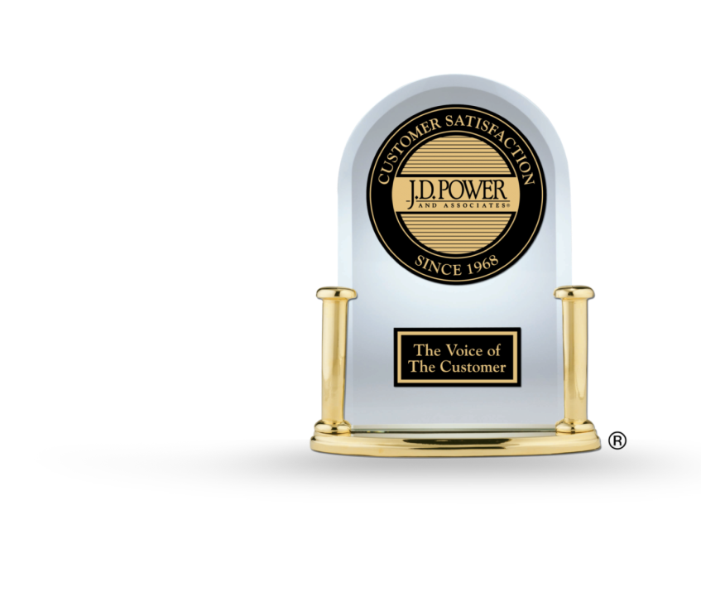
J.D. Power’s Objective:
Identify, translate, and implement best practices from iconic brands across industries to elevate the automotive customer experience

Slide 36

Why Customers Appear to be “Changing”
The balance of power has shifted from dealers to consumers
The Past
The Present
Limited Information for Consumers
Access to Information Any Time, Anywhere Through Mobile
Lack of Price and Trade Transparency
Near Complete Transparency
Dealers in Control
Customers in Control
Control allows customer to choose a brand and dealer that most effectively meets their needs

Slide 37














Experiences Set NEXTpectations
The dealership experience is being judged against leading brands across all industries

Slide 38
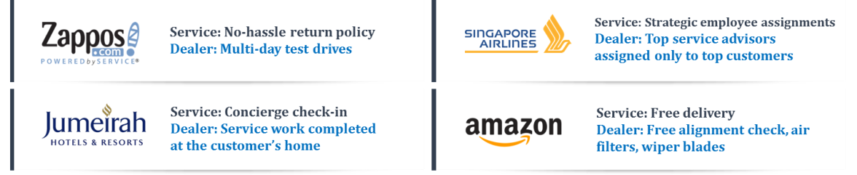
Looking outside Automotive
Savvy dealers are looking to retail leaders outside of automotive for customer experience best practices…

Slide 39


Customer Empowerment / “Metailing”
Businesses are responding by delivering personalized experiences designed to meet each individual’s unique needs
Purchasing the desired product or service is only part of the experience
Customization of the shopping process provides differentiation
Service industries offer customers a unique experience that would otherwise be lacking in noteworthiness
Individualization of services is an opportunity to turn a “painful” activity into a loyalty moment
  “Wow, I didn’t expect that”, or
  “Wow, that was vastly improved”
Notes:
Individualized Buying / Ownership Experiences
Obtaining the desired product or service is only part
of the path to fulfillment for an increasing number of customers
Having the ability to customize the shopping
experience so that it is unique, one-of-a kind,
is also highly desirable—particularly since most
items bought are not unique
Service also offer the opportunity for customers to enjoy a unique experience on an activity that can be otherwise lacking in noteworthiness
Individualization of services is an opportunity to turn a “painful” activity or one perceived as a commodity, into a unique greater value experience

Slide 40












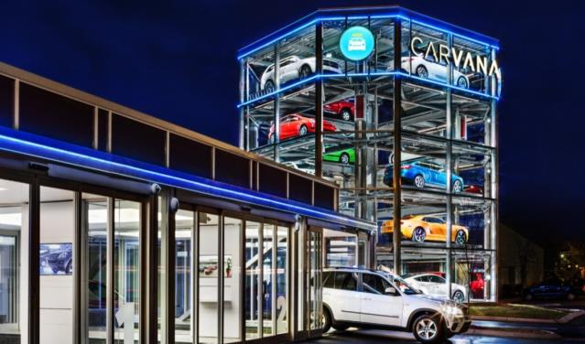
The Emerging Threats
Dealers who ignore this CX evolution will be challenged by non-traditional competitors

Slide 41
Delivering an Elevated
Customer Experience

Slide 42

Three Essential Components
Reduce Customer time and effort
Increase operational efficiency
Support cross-channel experiences
Empowered and committed
Engaged
Trustworthy and credible
3.
Technology
1.
People
2.
Process
Consistent and measureable
Aligned with Customer NEXTpectations

Slide 43
Delivering an Elevated
Customer Experience:
1. People

Slide 44
The Issue
Turnover in the US across all industries averaged
Variable ops turnover in retail automotive average
Overall turnover in retail automotive average
16%
72%
39%
Compdata Surveys
NADA Workforce Study

Slide 45
What is it costing operators?
$3 Billion
1. Driving Sales

Slide 46
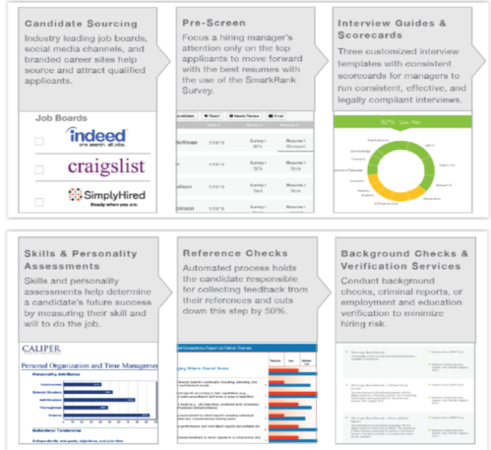
Example: The Hireology Process
Reduce Turnover
An End-to-End Hiring Process That Helps Dealers…
Save Time & Money
Protect Your Bottom Line

Slide 47
Delivering an Elevated
Customer Experience:
2. Process

Slide 48

Product parity is increasingly the rule Now more than ever, customer experience is a leading differentiator in automotive.

Slide 49

What are savvy dealers doing?
Looking to retail leaders outside of automotive for customer experience best practices…
Service
Empowers staff to resolve concerns and satisfy customers
Dealer
Empower employees to make reasonable decision to resolve customer concerns

Slide 50
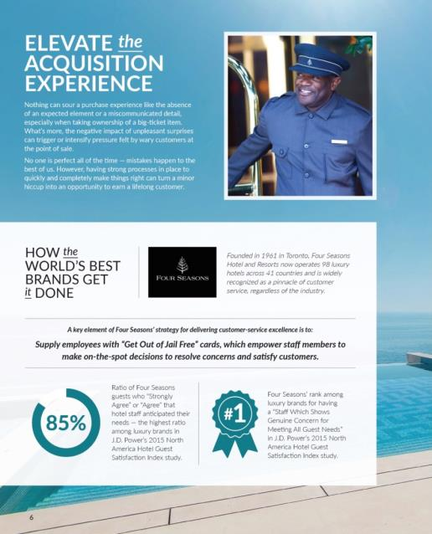
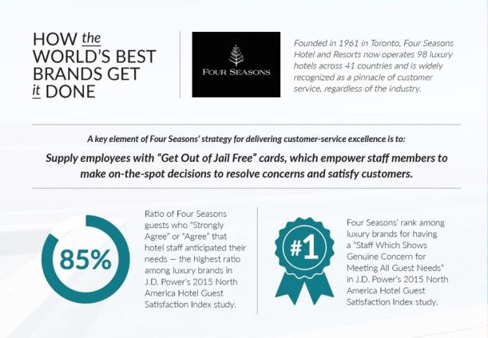
Example of Non-Automotive
Service:

Slide 51
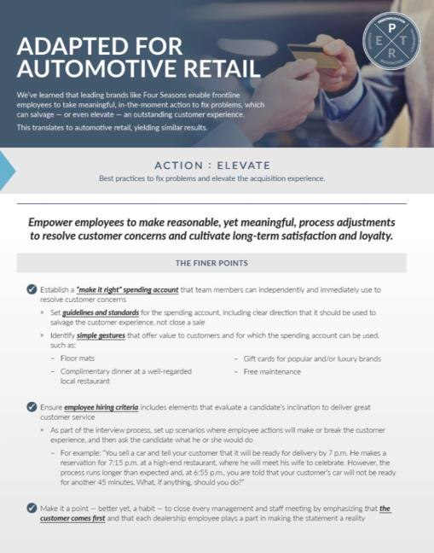
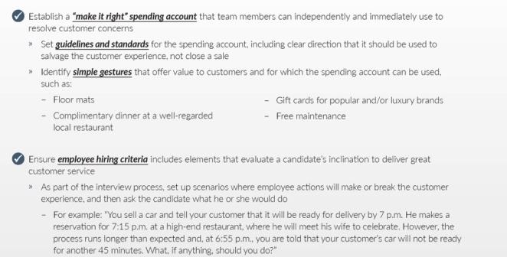
Application to Automotive:
Empower employees to make reasonable, yet meaningful, decisions to resolve customer concerns and cultivate long-term satisfaction and loyalty.

Slide 52
Delivering an Elevated
Customer Experience:
3. Technology

Slide 53
Customer Research Impacts Satisfaction
Dealers must embrace technology, particularly with Gen Y
Source: J.D. Power 2015 Sales Satisfaction Index (SSI) Study
Overall industry data

Slide 54

The Top 10 Technology Truths for Automotive Retail
It (technology) is pervasive – mobility has changed the game
It is relentless – you can’t fight it
It is forcing us to rethink how we engage with customers
It represents a unique and exciting opportunity for retailers to become customer experience leaders (yes, leaders!)
It will require significant investment from both automakers and dealers
It will change the way we hire and train
It will improve operational efficiency and (potentially) profitability
It will connect us to our customers on a continuous basis
It doesn’t mean that you no longer have to “sell”
It is available today – you don’t have to wait, you just have to act

Slide 55
Summary and
Recommendations

Slide 56
Summary and Recommendations
  Customer Expectations are evolving at a rapid pace
    Personalization and Technology are driving higher customer expectations
    Expectations are driven by experiences both in and out of the automotive industry
  The technology piece is key for both increased satisfaction and profitability
    This is particularly true among Gen Y who tend to adopt technology at higher rates and are less satisfied with their automotive experiences
  A robust system for analyzing and reacting to customer data needs to be in place to consistently deliver a superior customer experience
    This should include solicited and unsolicited data as well as transactional and relationship feedback

Slide 57
Thank You!

Slide 58

J.D. Power and Hireology
The Hireology platform is aligned with
J.D. Power research validating that lower turnover results to higher satisfaction
Hireology is an example of how J.D. Power is identifying “best-in-class” solutions that directly address industry pain points (i.e. employee hiring and retention)
J.D. Power and Hireology plan to analyze data ongoing and continue to validate results

